Slide 1
Cryptographic Hash Functions & Markle Tree
Smita Kulkarni-Pai

Slide 2
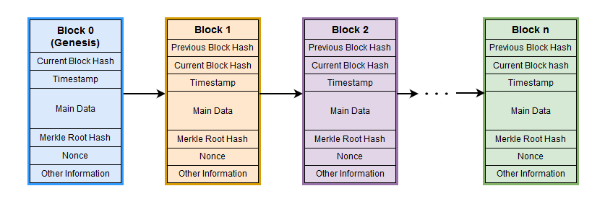
Block chain Architecture

Slide 3
Blockchain Architecture
Genesis Block in Blockchain:
The Genesis block in blockchain refers to the very first block created in a blockchain network. It serves as the foundation and starting point of the entire blockchain.
Header:
It is used to identify the particular block in the entire blockchain.
It handles all blocks in the blockchain.
A block header is hashed periodically by miners by changing the nonce value as part of normal mining activity, also Three sets of block metadata are contained in the block header.
Previous Block Address/ Hash:
It is used to connect the i+1th block to the i^{th} block using the hash. In short, it is a reference to the hash of the previous (parent) block in the chain.

Slide 4
Blockchain Architecture
Timestamp:
It is a system verify the data into the block and assigns a time or date of creation for digital documents.
The timestamp is a string of characters that uniquely identifies the document or event and indicates when it was created.
Nonce:
A nonce number which uses only once. It is a central part of the proof of work in the block.
It is compared to the live target if it is smaller or equal to the current target. People who mine, test, and eliminate many Nonce per second until they find that Valuable Nonce is valid.
Merkel Root:
It is a type of data structure frame of different blocks of data.
A Merkle Tree stores all the transactions in a block by producing a digital fingerprint of the entire transaction. It allows the users to verify whether a transaction can be included in a block or not.

Slide 5
Cryptographic Hash Functions in Blockchain
Cryptographic hash function in Blockchain is a way to secure the message block and is used to connect the blocks in a chain.
Briefly, In the blockchain, each block contains its own block hash and a hash of its previous block.
Which helps them to form a cryptographically secured linear chain of blocks.

Slide 6
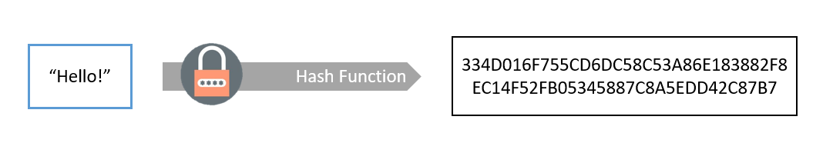
What is Hashing?
Hashing is converting an original piece of data into a digest or hash. The process uses cryptographic hash functions for the irreversible conversion of the message.
Source: https://www.shiksha.com/online-courses/articles/cryptographic-hash-functions-in-blockchain/

Slide 7
What are Cryptographic Hash Functions?
The hash function applies to the message to generate a message digest, a fixed-size hexadecimal output.
It takes an arbitrary size input as a message. INPUT M:The Message
Uses a Cryptographic hash function H to encrypt the message M.
Generates the output called Digest.
H(M) = Digest
Cryptographic hash functions are irreversible. That means it’s a 1-way function, and one can’t generate the message back using the digest.
There are a bunch of cryptographic hash functions. For example, SHA-224, SHA-256, SHA-512, KECCAK-256, Whirlpool, etc.
https://www.investopedia.com/terms/m/merkle-tree.asp

Slide 8
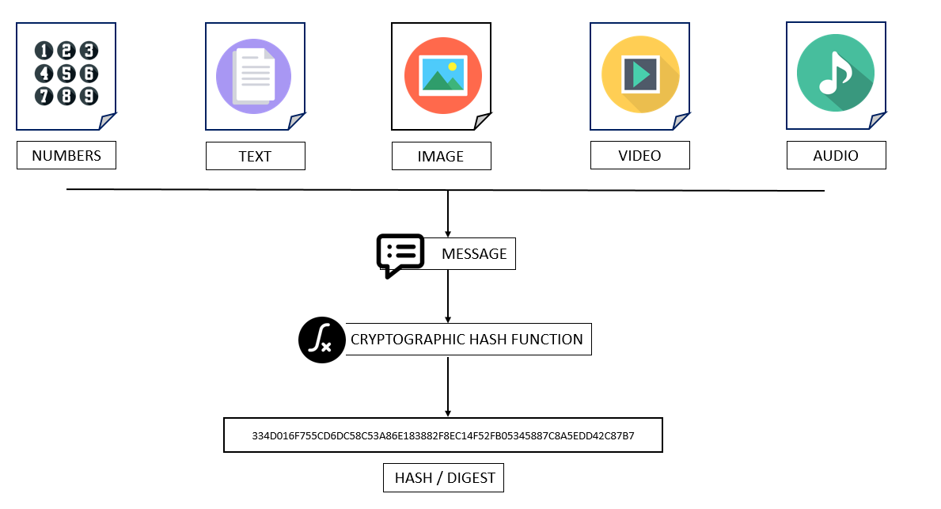
Source: https://www.shiksha.com/online-courses/articles/cryptographic-hash-functions-in-blockchain/

Slide 9
Properties of Cryptographic Hash Functions
The process of hashing secures the message and makes the computation easy. It compresses the message into hash/digest, which is efficient for computation and communication. Briefly,
Above all, below are the properties of cryptographic hash functions.
Deterministic
Unique output (or hash)
One-way function (Irreversible)
Collision Resistant
Avalanche Effect

Slide 10
Properties of Cryptographic Hash Functions
Deterministic
Cryptographic hash functions are deterministic. It always generates the same hash for the same input data. However, even if a single letter changes, the hash changes dramatically.
For instance: M: Hello → SHA-256(M) → 185F8DB32271FE25F561A6FC938B2E2643…….. M: HellO → SHA-256(M) → 4FF7975B53DB6C029D88F6AC67BD78D1……….

Slide 11
Properties of Cryptographic Hash Functions
It produces a unique output (or hash)
No other algorithm or input can produce same output as that of hash.
Output produced by hash functions are unique
https://www.investopedia.com/terms/m/merkle-tree.asp

Slide 12
Properties of Cryptographic Hash Functions
A one way function
A one-way hash function, also known as a message digest, is a mathematical function that takes a variable-length input string and converts it into a fixed-length binary sequence that is computationally difficult to invert—that is, generate the original string from the hash.
These are also called Irreversible functions.
https://www.investopedia.com/terms/m/merkle-tree.asp

Slide 13
Properties of Cryptographic Hash Functions
Collision Resistant
Hash functions are one way. For a given X, it’s easy to calculate H(X)=D. In contrast, using D, one can’t find X.
However, there’s a little possibility of getting H(X)=H(Y); where X is not equal to Y. And, it’s difficult to find X and Y using the same hash.
For instance, if a hash function produces N bits of output. An attacker needs to compute 2^(N/2) hash operations on random input to search for the second match of the output.
Hence, for every 256 hash functions, the attacker must compute 2^128 hash operations. Even if one computation takes 1 microsecond, it will require approximately 10^25 years to match the output.
Hence they are called collision resistant.
https://www.investopedia.com/terms/m/merkle-tree.asp

Slide 14
Properties of Cryptographic Hash Functions
Avalanche Effect
In cryptography, the avalanche effect is the desirable property of cryptographic algorithms, typically block ciphers and cryptographic hash functions, wherein if an input is changed slightly (for example, flipping a single bit), the output changes significantly (e.g., half the output bits flip).
In the case of high-quality block ciphers, such a small change in either the key or the plaintext should cause a drastic change in the ciphertext.
This avalanche effect property of hash functions helps to identify tampering of data.
https://www.investopedia.com/terms/m/merkle-tree.asp

Slide 15
Properties of Cryptographic Hash Functions
Some of the Hash families available are Message Direct (MD), Secure Hash Function (SHF), and RIPE Message Direct (RIPEMD).
SHA 256 is widely used hash function in Blockchain.
https://www.investopedia.com/terms/m/merkle-tree.asp

Slide 16
Merkle Tree

Slide 17
Merkle Tree
In cryptography and computer science, a hash tree or Merkle tree is a tree in which every "leaf" (node) is labelled with the cryptographic hash of a data block, and every node that is not a leaf (called a branch, inner node, or inode) is labelled with the cryptographic hash of the labels of its child nodes.
A hash tree allows efficient and secure verification of the contents of a large data structure.
A hash tree is a generalization of a hash list and a hash chain.
https://www.investopedia.com/terms/m/merkle-tree.asp

Slide 18
Merkle Tree
Merkle trees are used in distributed systems for efficient data verification. They are efficient because they use hashes instead of full files.
Hashes are ways of encoding files that are much smaller than the actual file itself.
Currently, their main uses are in peer-to-peer networks such as Tor, Bitcoin, and Git.
In bitcoin and other cryptocurrencies​, Merkle trees serve to encode blockchain data more efficiently and securely.
They are also referred to as "binary hash trees."
https://www.investopedia.com/terms/m/merkle-tree.asp

Slide 19
Breaking Down Merkle Tree
In bitcoin's blockchain​, a block of transactions is run through an algorithm to generate a hash, which is a string of numbers and letters that can be used to verify that a given set of data is the same as the original set of transactions, but not to obtain the original set of transactions.
Bitcoin's software does not run the entire block of transaction data—representing 10 minutes' worth of transactions on average—through the hash function at one time, however.
https://www.investopedia.com/terms/m/merkle-tree.asp

Slide 20

Breaking Down Merkle Tree
Block
Rather, each transaction is hashed, then each pair of transactions is concatenated and hashed together, and so on until there is one hash for the entire block.
(If there is an odd number of transactions, one transaction is doubled and its hash is concatenated with itself.)
Block
Block
H 1-500
H 1-250
H 251-500
H12
H34
H499-500
H1
H2
H3
H4
H499
H500
Tx1
Tx2
Tx3
Tx4
Tx499
Tx500

Slide 21
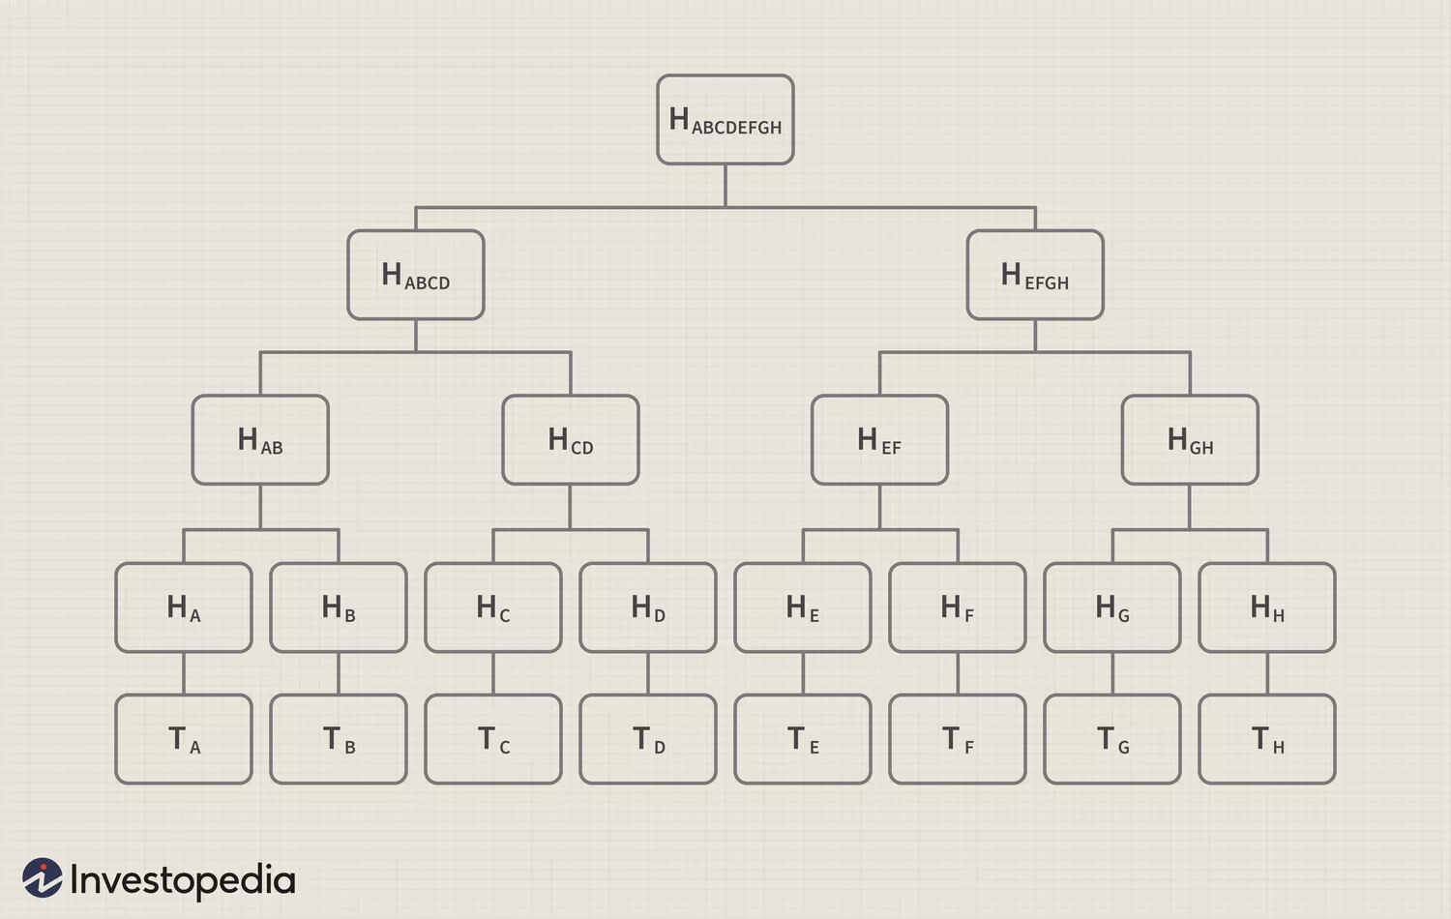
Breaking Down Merkle Tree
Visualized, this structure resembles a tree. In the diagram below, "T" designates a transaction, "H" a hash. Note that the image is highly simplified; an average block contains over 500 transactions, not eight.2
Source: https://www.investopedia.com/terms/m/merkle-tree.asp

Slide 22
Breaking Down Merkle Tree
The hashes on the bottom row are referred to as "leaves," the intermediate hashes as "branches," and the hash at the top as the "root."
The Merkle root of a given block is stored in the header:
for example, the Merkle root of block #482819 is
The root is combined with other information
(the software version,
the previous block's hash,
the timestamp,
the difficulty target,
and the nonce)
and then run through a hash function to produce the block's unique hash:
in the case of block #482819.
This hash is not actually included in the relevant block, but the next one; it is distinct from the Merkle root.
e045b18e7a3d708d686717b4f44db2099aabcad9bebf968de5f7271b458f71c8
Merkle Hash
Software Version
Prev. Hash
Timestamp
Difficulty Target
Nonce
}
Hash for Next Block
000000000000000000bfc767ef8bf28c42cbd4bdbafd9aa1b5c3c33c2b089594
https://www.investopedia.com/terms/m/merkle-tree.asp

Slide 23
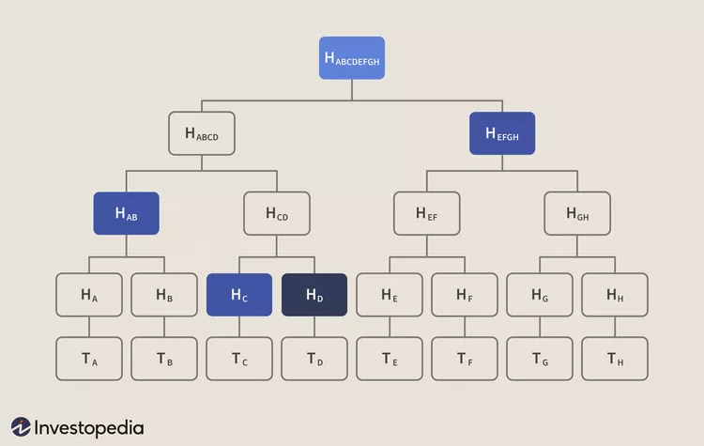
Breaking Down Merkle Tree
The Merkle tree is useful because it allows users to verify a specific transaction without downloading the whole Blockchain (over 350 gigabytes at the end of June 2021).
For example, say that you wanted to verify that transaction T_{D} is included in the block in the diagram above.
If you have the root hash (H_{ABCDEFGH}), the process is like a game of sudoku: you query the network about H_{D}, and it returns H_{C}, H_{AB,} and H_{EFGH}.
The Merkle tree allows you to verify that everything is accounted for with three hashes: given H_{AB}, H_{C}, H_{EFGH,} and the root H_{ABCDEFGH}, H_{D} (the only missing hash) has to be present in the data.

